Slide 1
Reference Passing
Pass by value

Slide 2
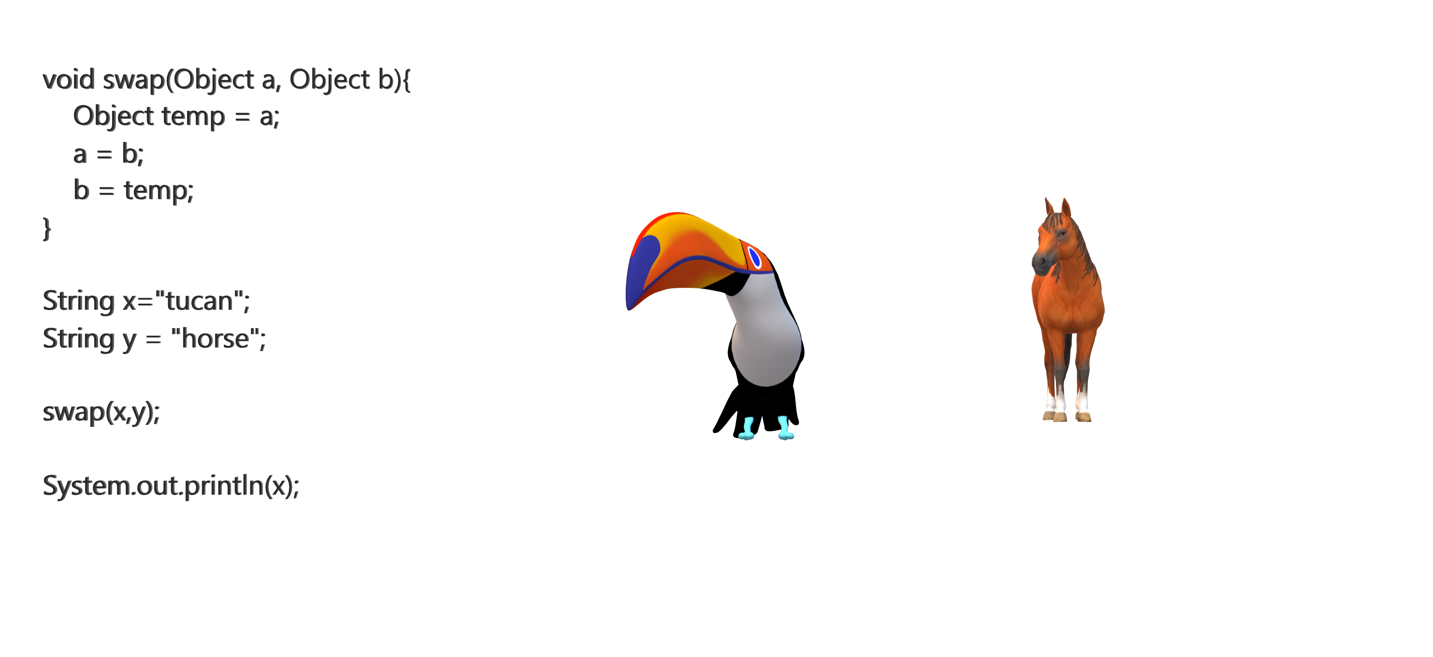
What prints out – tucan or horse?

